Slide 1
Broadcast Technology UG1
Signals
Jerry Foss
jeremy.foss@bcu.ac.uk

Slide 2
The Signal
The Channel
From Analogue to Digital
Bandwidth
Why Sine Waves ?
Pulse Transmission, Interference (ISI)
Noise
Signal Distortion
IRE Levels

Slide 3
Why
Sine
Waves ???

Slide 4
Why sine (sin) Waves?
sine (sin):
sin α =
c
(hypotenuse)
i.e. a ratio of the opposite side and hypotenuse of a right-angled triangle
for α = 0° ⇨ 90 °
sin α = 0 ⇨ 1.00
notable value:
sin 30 ° = 0.500
a
(opposite)
α
b
(adjacent)

Slide 5
sine (sin)
c
a
α
b
sin
1.0
0.5
0
sin α =
Plotting values of sin α between 0° and 90° gives a graph ....
α
0° 30° 90°

Slide 6
sine (sin)
c
a
α
b
sin α
1.0
0.5
0
as α continues past 90° and towards 180°, the value sinα falls back to 0
α
0° 30 ° 90° 150° 180°

Slide 7
sine (sin)
as α continues past 180°, sin α goes negative
... then falls from 0 (at 180°) through -1 (at 270°)
... and back up to 0 at 360°
360° = 0°
... and the cycle starts over ...
c
a
b
α
1
0
-1
sin α
α
0 90 180 270 360 = 0 450 = 90

Slide 8
sine (sin)
As α continues, the curve of sin α forms a sin wave
sin α
0 90 180 270 0 90 180 270 0 90
360 450 540 630 720 810 ………

Slide 9
Waveforms: Wavelength, Frequency and Period
unit of wavelength
= any length unit
mm, cm, m ...
One wavelength “λ”
Wave “travelling”, imagine an observer counting the wavelengths:
frequency = number of wavelengths / unit of time
i.e.
velocity = frequency x wavelength
v
f λ

Slide 10
Waveforms: Wavelength, Frequency and Period
unit of wavelength
= any length unit
mm, cm, m ...
One wavelength “λ”
Period of the wave, time in seconds
(more likely mS or μS)
The period of the wave = T = the length of time for one wavelength
f T= 1 second

Slide 11
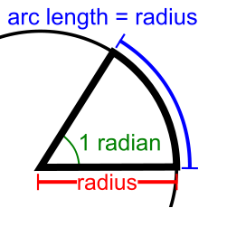
Radians
r
Circumference
= πD
= 2πr
D
Radian
= the angle where the arc swept = the radius of the circle
i.e. 1 Rad = 180/π° ≈ 57.3 °
i.e. 2π Rad = 360 °
360°
So if we take an arc around the circle the same length as the radius (r)
It will trace an angle of 57.3°
… call this an angle = 1radian
But consider - how many radius lengths are there around the circmference?
= 2πr ÷ r
= 2π

Slide 12
The Signal

Slide 13
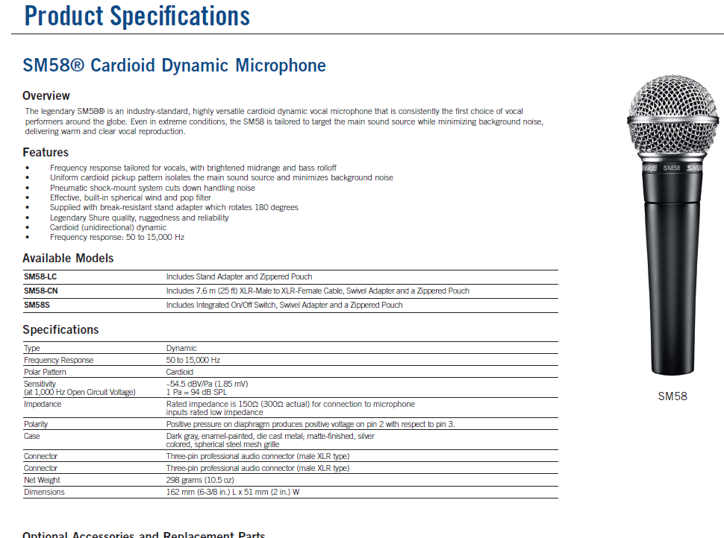
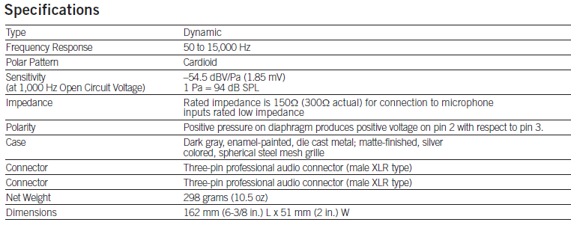
Shure SM58 Specifications
http://www.shure.com/idc/groups/public/documents/webcontent/us_pro_sm58_specsheet.pdf
Output voltage ~ 0.19mV =

Slide 14
RMS Voltage, e.g. Mains Supply
AC Power supply in UK (and the rest of Europe) is 230V AC
AC = “alternating current”
… alternating at a rate of 50 Hz (cycles per second)
North America = 120V @ 60Hz
Varies quite a bit around the world
Peak = ~340V
RMS = 230V
0V
t
f-= 50Hz
Problem: What is the “average” value of the sinusoidal waveform?
Answer: Zero … but obviously this is misleading
Mathematically this is expressed as RMS … Root Mean Square
Practically, could consider the RMS voltage as the voltage required to produce the equivalent power (e.g. heating effect ) as a DC voltage

Slide 15
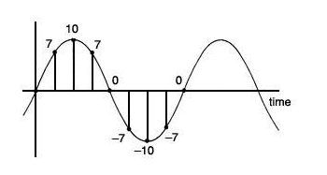
Root Mean Square
For example: suppose the time samples are as shown in the diagram:
(note: eight samples)
Values 0 7 10 7 0 -7 -10 -7
Squares 0 49 100 49 0 49 100 49
Sum of squares = 396
Average of squares = 396/8 = almost 50
Square root = approx 7
With more intervals the rms average turns out to be
= (peak value) / √2
= peak value/1.41
= 0.707peak value
http://www.practicalphysics.org/go/Guidance_107.html

Slide 16
Root Mean Square – the Power Supply
240V RMS, 50Hz:
V_{peak} = √2 x V_{rms}
√2 = 1.414
Peak = ~340V
RMS = 230V
0V
t
one cycle = 1/50th second
tolerance of +10%, -15%

Slide 17
Analogue Signal - for example …
amplitude
= zero?
volts?
time
= zero?
DC Bias
time

Slide 18

Analogue Signal - for example …
amplitude
= zero?
time

Slide 19
The Channel

Slide 20
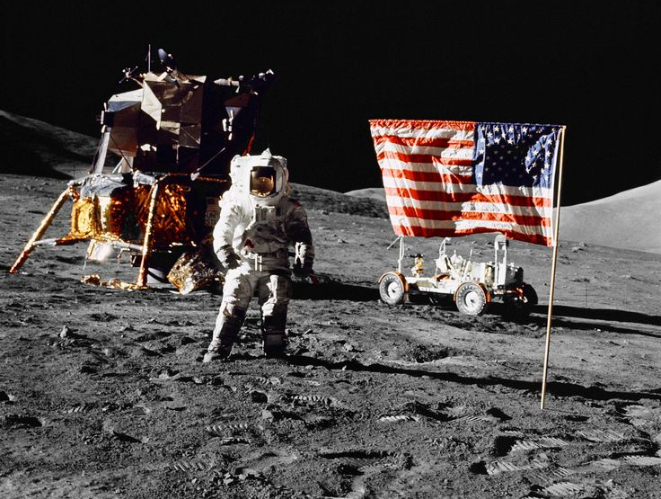

Slide 21
Signal and Channel
Transmitted Signal
Channel
Received Signal
External Influences
(interference)

Slide 22
Analogue Signal Problems In The Reproduction Process
Original signal
phase effects
interference
other signals crosstalk
various intermodulation products
mechanical transducer ineffective / inefficient
Reproduced signal

Slide 23

MSc Digital Broadcast Technology: Signal Compression and Encoding
Information Transmission, Signal Encoding
Information
Source Information
coded data in as small space as possible (compressed, etc)
Information
Source Coding
Source Decoding
Channel Coding
Channel Decoding
bit errors
Channel coding
appropriate error protection method
... depends on channel characteristics
Modulation
… on to carrier
Modulation
Demodulation
signal received – reverse processes
Transmission Link
Interference
Distortion
Attenuation
transmission is subject to noise interference
aim – to approach the Shannon Limit
jeremy.foss@bcu.ac.uk

Slide 24
Pulse Transmission,
Interference (ISI)
Eye Diagrams
Original generated signal → transmission system → received signal

Slide 25
Quality of the Transmission
Theoretically perfect random pulse train
Pulse train: two or three pulse periods successively sampled, overlayed on each other
Random pulse train affected by imperfect transmission medias
Practical pulse train: successively sampled, overlayed

Slide 26
Jitter
theroretical clock pulses
actual clock pulses
degraded pulse train received
smearing and delay
overshoot (“ringing” at filters)
Distribution of clocking arising through various issues, e.g. arising through the nodes transmission
pulse train cleaned up at receiver

Slide 27
Eye Diagram - test set-up
Clock In
DATA GENERATOR
CHANNEL
OSCILLOSCOPE
Y-INPUT Ext Trigger
Clock Out
one pulse interval
Sampling Instant

Slide 28
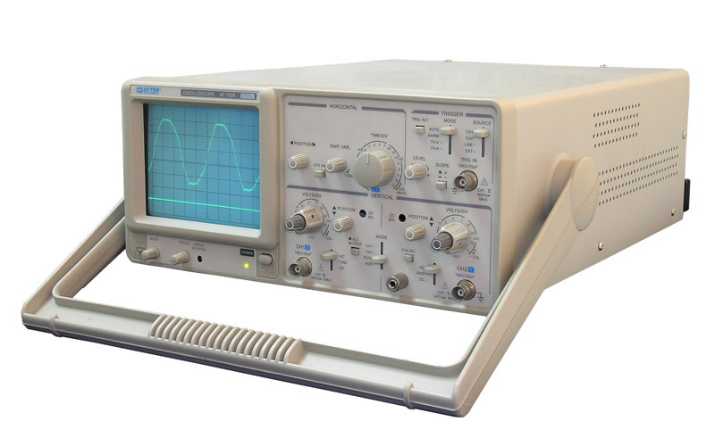
ISI – Eye Diagram
Demonstrated by “eye pattern” analysis of impulse response
It indicates the performance of a transmission system
original generated signal → transmission system → received signal
a run of pulses are fed into a scope –
locked on to one or two pulse widths
superimposed 1’s and 0’s

Slide 29
Different Eye Patterns
Signal only - various small individual random distortions (but likely OK)
- eye is “open”
Signal + timing errors - eye closing
Signal + noise - eye closing (amount depends on noise)

Slide 30
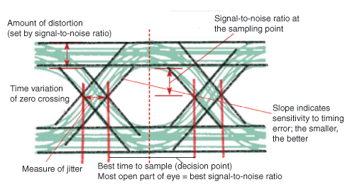
ISI – Eye Diagram
Can reveal important information
best point for sampling
SNR at the sampling point
amount of jitter and distortion
time variation at zero crossing - jitter
http://www.edn.com/design/test-and-measurement/4389368/Eye-Diagram-Basics-Reading-and-applying-eye-diagrams

Slide 31
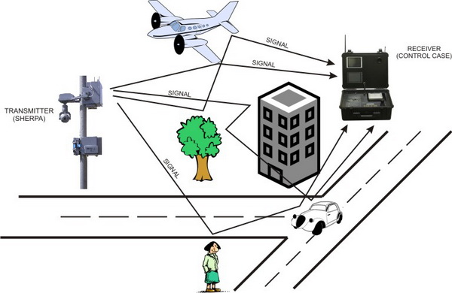
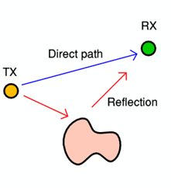
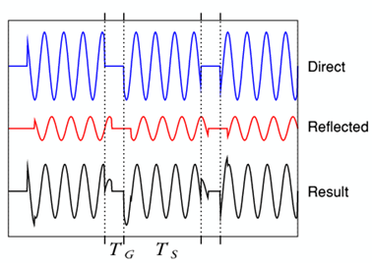
Multipath
an undesirable effect – reflections of radio waves hitting various objects in the environment
unavoidable
http://www.st-andrews.ac.uk/~www_pa/Scots_Guide/RadCom/part19/page3.html
i.e. interference between a symbol and its own reflection … another form of ISI

Slide 32
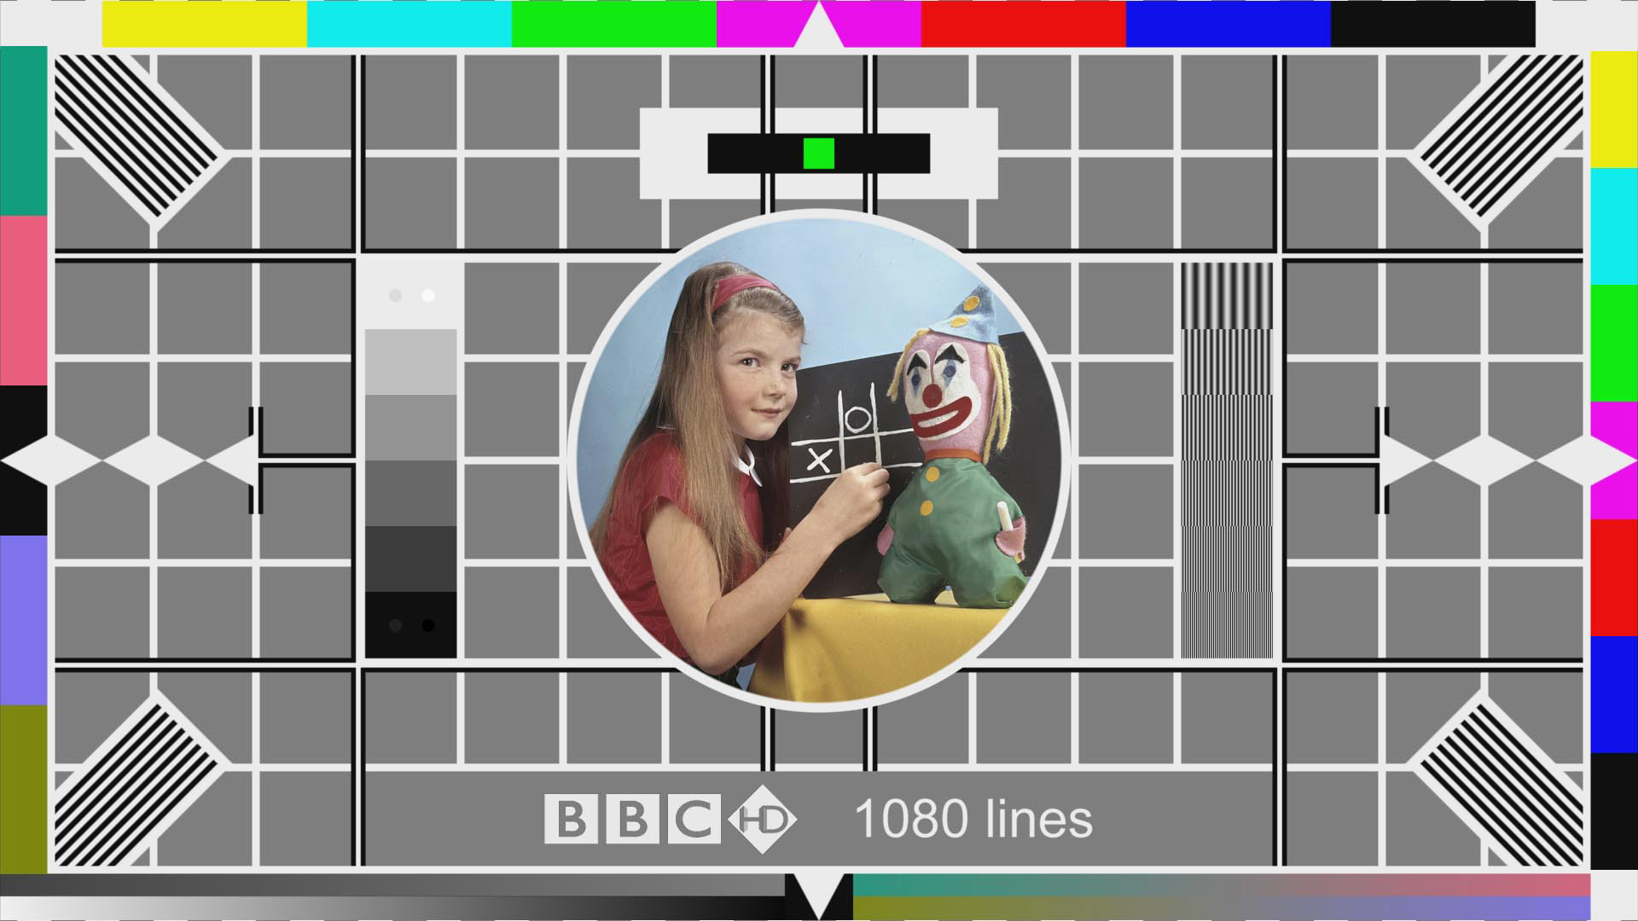

Slide 33
Bandwidth

Slide 34
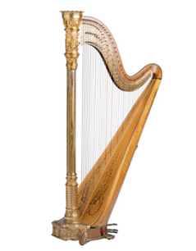

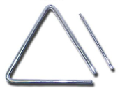
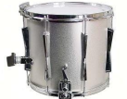
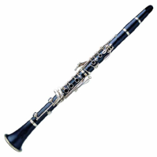
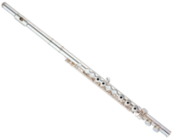
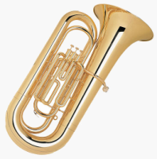
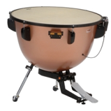

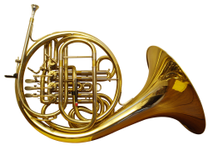

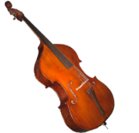



Frequencies, Bandwidth – fundamental freqs
∼2KHz
Bandwidth = ∼2kHz
frequency
∼80Hz

Slide 35
Frequencies, Bandwidth – add the harmonics
Bandwidth = ∼20kHz
frequency
∼80Hz

Slide 36

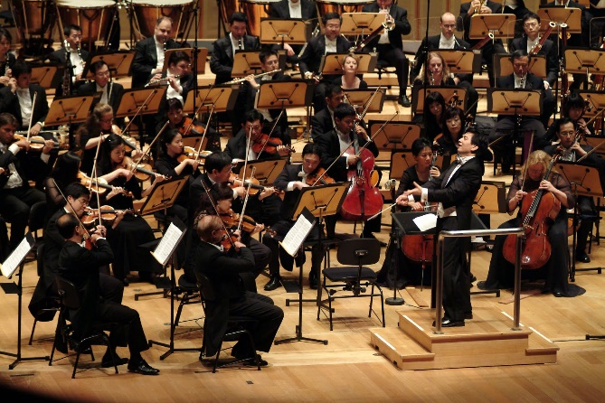
Bandwidth – Analogue Signals
Bandwidth = 20KHz
freq
~20Hz
~20kHz
Baseband signals – the range of frequencies of the original signal
… unmodulated, not frequency shifted

Slide 37

Sampled Bandwidth – Analogue Signals
Telephone bandwidth = 4KHz
∴ ten calls can be stacked into a 40KHz bandwidth
freq
40kHz
40KHz communications channel

Slide 38
Digital Signals, Bandwidth and Spectra
Does Analogue Bandwidth relate to Digital Bandwidth?
... it depends ... but not an accurate relationship
Digital Bandwidth: Data rate in bits/second
= bandwidth of the communications channel
e.g. 20kHz signal, sampled at 44.1kHz
with 16b coding (= 65536 quantisation levels) = 44100 x 16b per second
= 705600 b/s = 689kb/s
… for stereo = 689 x2 = 1378kb/s = 1.378Mb/s
compress to mp3 @320kb/s; bandwidth = 320kb/s
compress this to mp3 (or aac) @128kb/s; bandwidth = 128kb/s
typical SD TV channel, avc =>3Mb/s
typical HD TV channel, avc = >8Mb/s
depends on no of bits, compression, etc
but consider the practical transmission channel
… the modulation level; channel S/N

Slide 39
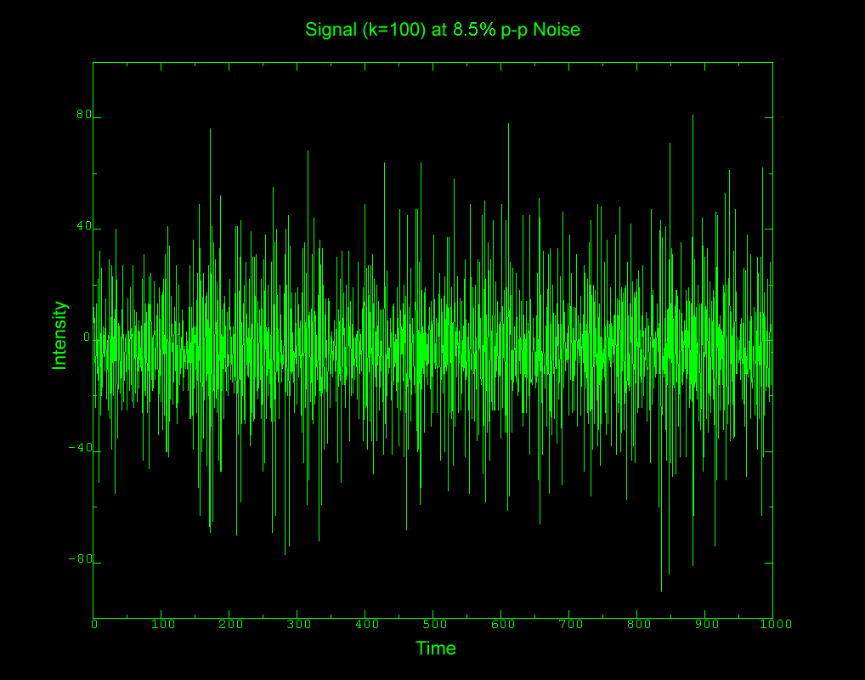
Noise

Slide 40
Noise
IMPORTANCE
for audio or video:
… noise is an obvious disturbance to the original noiseless signal
for data transfer
… noise can obliterate data; can reduce data rates; require retransmissions, etc
Nature of noise
typically random – a stochastic process
Noise is manifested as a voltage
… alongside the voltage of the original signal
Various causes of noise
(see noise types …)
Need ways to measure and represent noise
signal / noise ratio
Useful noise (sometimes)
white and pink noise

Slide 41
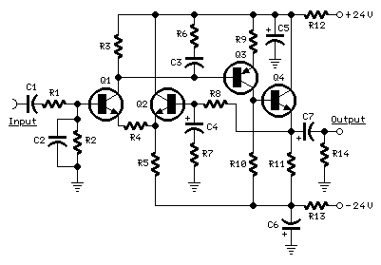
Noise
signal
noise
signal + noise

Slide 42





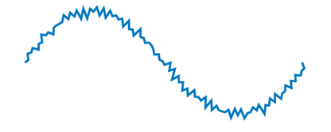
Channel Noise
clean signal
channel noise
E/M interference
additive
noise affected signal

Slide 43
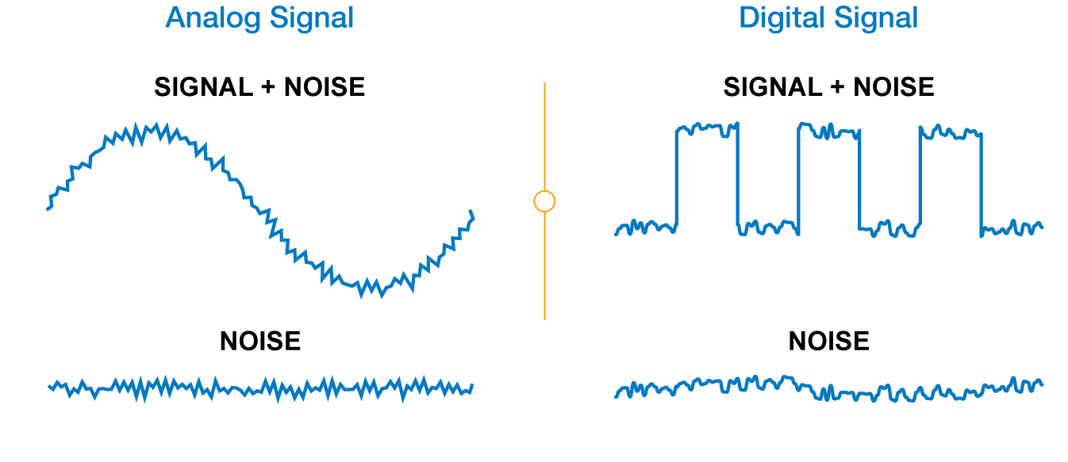

Slide 44
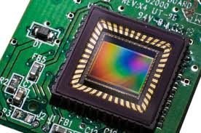

Sensor Noise
any active circuit (and many passive circuits) including camera sensors will produce noise ...
original image = pure grey tone
At the instant of image capture:
+ =
photocell charge plus negative noise spike = darker pixel
recorded image = noisy grey tone
+ =
photocell charge plus positive noise spike = brighter pixel

Slide 45
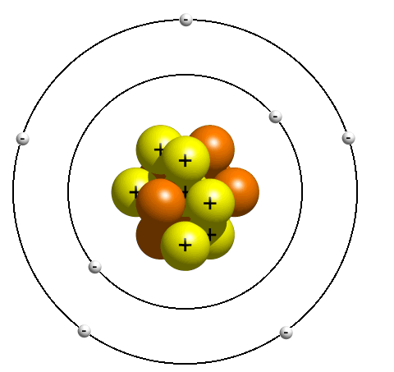
Conduction
Movement of electrons in ONE direction gives rise to ELECTRIC current
... is really a movement of CHARGE
No field – haphazard movement
... net current flow is zero
Conductors (metals, e.g. Copper) – have loose bindings to their outer electrons
-
-
-
electrons progress through conducting medium attracted towards positive electrode of the electric field.
they may be attracted to a nearby positive ion, or may continue drifting towards the anode

Slide 46
Conductors
CONDUCTORS
allow electrons to flow
electrons easily freed and move through lattice of atoms when electric field is applied
e.g. – gold, copper, tin, carbon
electron flow
-
-
-
INSULATORS
restrict movement of electrons
electrons firmly bound to atom
current flow

Slide 47
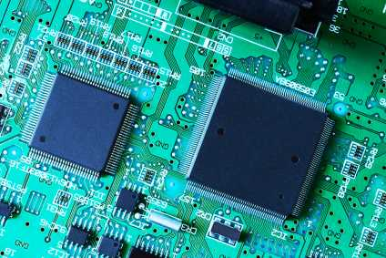
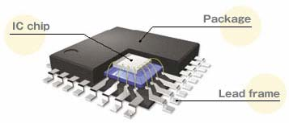
Semiconductors
Operate as both/either conductors or insulators under controlled circumstances
… i.e. within a circuit
Applications
diodes, transistors – CPUs (millions of transistors), sensors
Some semiconductors are intrinsic
... but usually doped to assist the semiconductor action
Semiconductor materials
Germanium (Ge), Silicon (Si)
Have impurities (doping) added to their crystal lattice structures to make n-type or p-type semiconductors

Slide 48
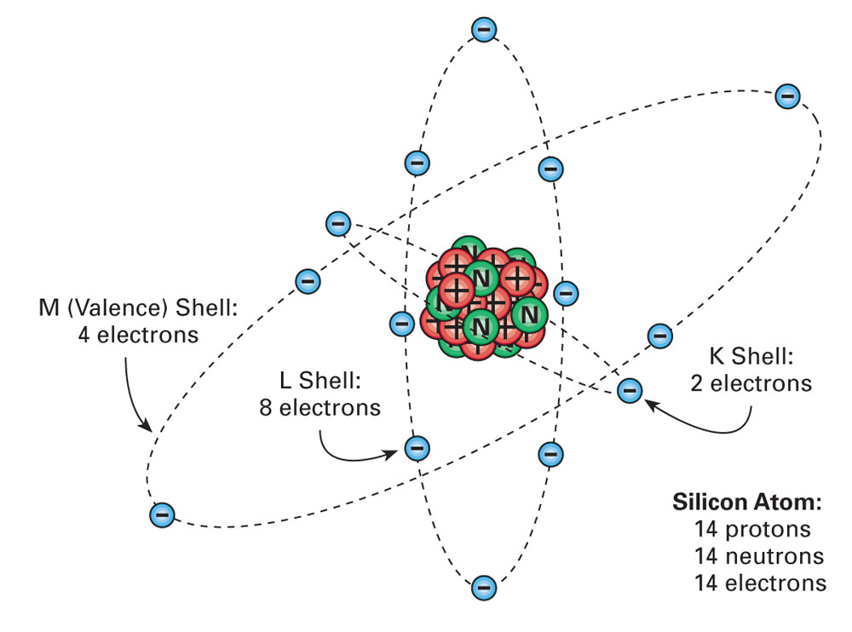
Semiconductor – Silicon atom
(positive charge)
(neutral charge)
(negative charge)

Slide 49
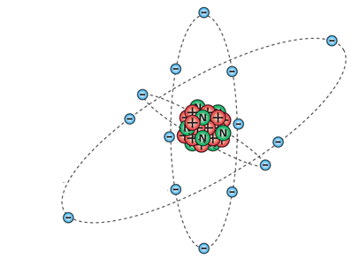
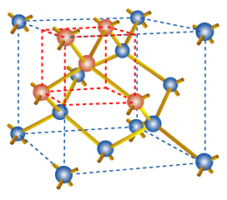
Semiconductor – Silicon atom
Covalent bonds – share atoms to bond and join atoms …
… into a lattice structure

Slide 50
Semiconductors (simplified 2D view of the lattice)
for n-type
“Donor” impurities
Antimony
Arsenic
Phosphorus
introduces “free” electrons
Antimony (Sb) impurity
donor impurity introduces free electrons
Si
Si
Sb
Si
Si
for p-type
“Acceptor” impurities
Boron
Aluminium
Gallium
introduces “holes” – room for free electrons
Si
donor impurity creates a hole
Si
B
Si
Si
Boron (B) impurity

Slide 51

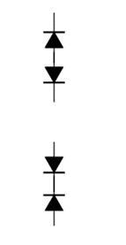
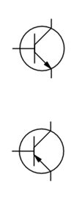

P-N Junctions
✓
Semiconductor Diode
current readily flows
p-type silicon
n-type silicon
current doesn’t readily flow
Transistors
here – Bipolar junction
top – NPN transistor
bottom – PNP transistor
other types – FET (field effect)

Slide 52

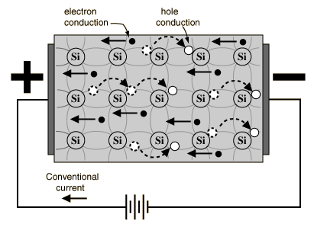
P-N Junctions
✓
current readily flows
Semiconductor Diode
p-type silicon
n-type silicon
current doesn’t readily flow

Slide 53
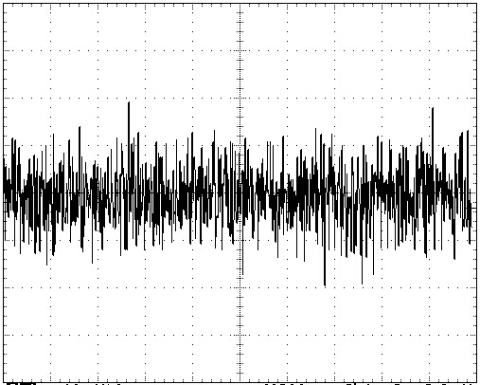


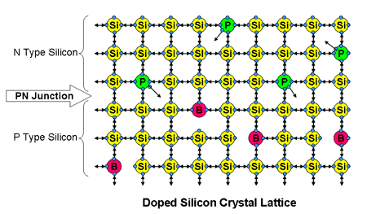
Noise - Causes
SHOT NOISE
Random noise
due to electron flow – i.e. discrete events
… rather than a smooth flow
also photons in an optical transmission
significant problem with low signal levels
generally across all frequencies
current flow
noise voltage
frequency
noise voltage
time
THERMAL NOISE (JOHNSON–NYQUIST NOISE)
thermal effects agitating the electrons in a circuit
increases with temperature
i.e. kinetic energy of molecules of the crystal lattice of semiconductor

Slide 54
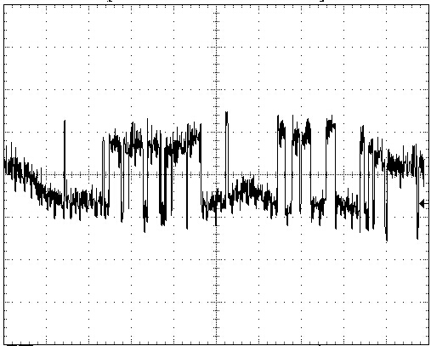
Noise - Causes
FLICKER NOISE
recombination / reforming of electron holes in a semiconductor structure
occurs in low frequecy range
dropping off towards higher freqs with a 1/f characteristic (like Pink Noise)
noise voltage
noise voltage ∝
freq
Random white noise (e.g. shot noise) (in time and freq)
BURST NOISE; IMPULSE NOISE (“popcorn noise”)
noise spikes in the lower audio range
different distinct levels of noise
in audio circuits amplified into speakers, sounds like popcorn popping
occurs in semiconductors
due to imperfections in the semiconductor material
time
Impulse (popcorn) noise

Slide 55
Noise – Other Causes
Several other causes of noise:
nearby interference sources
contact noise - oxidation on contacts
avalanche noise - caused at a semiconductor junction
partition noise - electrons flowing between a number of electrodes
grain noise – e.g. granularity of media – e.g. tape coatings, etc
etc

Slide 56
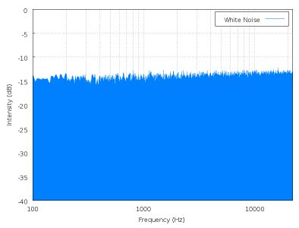
White Noise
0
-5
-10
-15
-20
-25
-30
-35
-40
intensity (dB)
Flat power-spectral density
i.e. noise power is the same across the frequency spectrum
(theoretically from 0Hz to ∞ Hz
practically – over a specified frequency range
1000 10,000
freq (Hz)

Slide 57
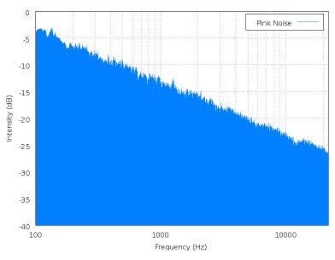
Pink Noise
0
-5
-10
-15
-20
-25
-30
-35
-40
intensity (dB)
Spectral Density is inversely proportional to frequency
i.e. intensity ∝
actually drops 3dB / octave
(again) theoretically 0Hz to ∞ Hz
1000 10,000
freq (Hz)

Slide 58
Noise – White, Pink
Depending on frequency spectrum, i.e. the amplitude of the noise voltages across the freq range
WHITE NOISE
has an increased intensity of 3dB for each octave increase
because each octave is twice the frequency range of the previous octave
PINK NOISE
power density drops 3dB intensity per octave
therefore amount of power is the same in octave ranges:
e.g. power in range 100 – 200 Hz
= power in range 1KHz – 2 KHz
therefore is useful for audio measurements
1….....…2…………………..3…………………………………………4 …. octaves
100…200……400……………….800…………………………………..1.6KHz….
freq (Hz)

Slide 59
Frequency and Time Domains
This response (from the previous slide) is of intensity over the frequency range … i.e. observed in the the frequency domain
Observing the noise-producing circuit over a period of time, we see only the changes in signal amplitude (i.e. intensity)
signal amplitude
time
This is a snapshot in time of the frequency domain

Slide 60
Noise is Probabalistic
i.e. – (below) - can’t be certain that intensity is at any specific value at any specific frequency
signal amplitude
time
… or that noise voltage amplitude = any specific value at any specific time

Slide 61
Noise is Probabalistic; Measuring Noise
As noise is random, it’s mean value will be (usually) zero
∴ use mean square values for measurements of the dissipated noise power
The effective noise power of a source is measured in root mean square (RMS)

Slide 62
Measuring Noise: Signal to Noise Ratio (SNR)
Comparison of
the power of the required signal
against the power of the (usually) unwanted noise
measured in decibels (dB)
signal
SNR (dB) =
noise

Slide 63
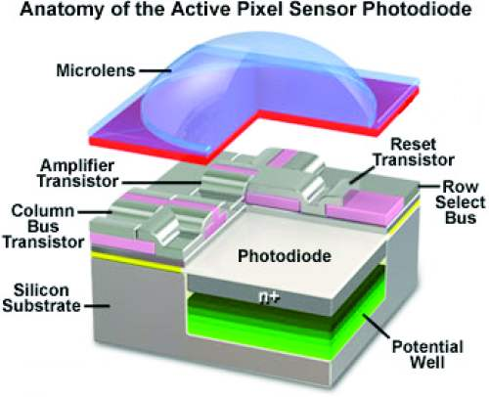
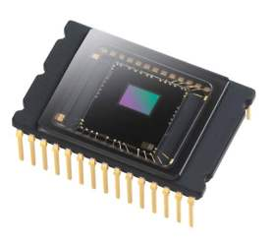
Photoelectric effect
photon strikes the diode
excites an electron
creating a free electron and a (positively charged electron hole)
current is produced - photocurrent

Slide 64
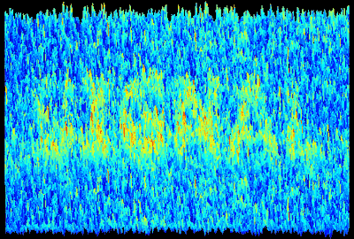
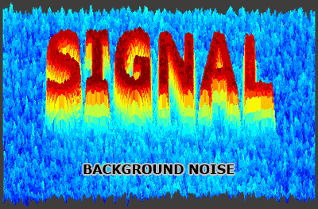
Dynamic Range – Camera Sensor, Signal to Noise
signal: the light which hits the camera sensor
noise is unavoidable
can be small relative to the signal
appears to be nonexistent
signal strength
Signal to noise ratio (SNR)
compare relative amounts of signal and noise
used for any electronic system
image signal
constant noise level
light level
noise low ratio = much noise high ratios = very little visible noise
http://www.cambridgeincolour.com/

Slide 65



Dynamic Range – Camera Sensor, Photosites
Camera sensors – each photosite accumulates charge in response to the incident light
Figures below – accumulation of charge is like filling buckets with balls (or water ... whatever ...); actually electrons
Black level – at low level, is limited by the signal required to overcome the sensor noise.
White is limited by the highest level of charge accommodated in the photosite
... Depends on the capacity of the photosite. A lower capacity element may accommodate less light before it is saturated
… smaller sensors usually have lower capacities
… compact cameras, smaller sensors
Contrast ratio is the ratio between lowest level and highest level
lower ISO levels usually have bigger dynamic ranges, since there is less noise at low ISO black levels
Camera dynamic range usually measured in f-stops
e.g. contrast ratio of 1024 ≡ 2¹⁰,
i.e. 10 stops

Slide 66
(state
Dynamic Range – Camera Sensor, Photosites
Dynamic Range = Full Well Capacity
Camera Noise
= 20 log10 Full Well Capacity (stated as number of electrons)
Camera Noise (stated as number of electrons)
… … stated in decibels (dB)
Dynamic range improves if the full-well capacity is higher
… and the camera noise is lower
Parameters that affect the dynamic range:
Pixel size (Full-well capacity)
Temperature (Dark noise)
Readout rate (Readout noise)

Slide 67
Noise Factor, F_{n}
specifies how much additional noise the device will contribute to the noise already from the source.
The noise factor of a system is
the ratio of output noise power (P_{no})
to input noise power (P_{ni}):
Ideally F_{n} = 1
(because noise out would = noise in)
Noise sources are subject to temperature (thermal noise)
∴ needs to be measured at a standard temperature = T₀ = 20ºC; = 293K
F_{n}
F_{n} =
F_{n} =

Slide 68
Noise Figure, NF
Noise Figure NF is the Noise Factor in dB
NF = 10 Log₁₀ F_{n}
Noise Factor F_{n}:
F_{n} =
But – SNR is measured in dB
∴ NF = SNR_{in} – SNR_{out}

Slide 69
Signal Distortion
Frequency Distortion
certain frequencies are boost or cut unevenly across the audio spectrum
stated in equipment specifications as the components frequency response
Phase Distortion
given frequency from a complex waveform takes longer to pass through a signal chain than others: i.e. a phase shift in the individual frequencies
(amplitudes may be amplified equally over the entire frequency band, but the composite waveform has been varied)
Total Harmonic Distortion (THD)
most commonly known form of distortion
directly related to the percentage of harmonics generated by the components in the signal chain
Measured using Fourier Analysis
Intermodulation (IM) Distortion
modulation of combinations of spurious frequencies
the combination of resulting frequencies are equivalent to the sum and/or difference of integral multiples of the individual frequencies of a complex waveform
Transient Intermodulation (TIM)
solid-state amplifiers use negative feedback in order to improve frequency response and reduction of harmonic distortion
occurs during high-frequency music passages

Slide 70

Signal Distortion
Perfect Amplifier
?

Slide 71
Signal Distortion
Unintended distortion
component and board layout
connecting cables
component interiors
capacitance in transistors
capacitance to earth (of casing)
… causes filtering effects

Slide 72
Signal Distortion
Uneven frequency response
gives phase differences across the signal bandwidth
in
Lower freqs: OK
out
different frequencies have different phase responses
Circuit

Slide 73
Signal Distortion
Transient response – circuit can’t react immediately to changes in signal
in
circuit produces rounding of edges due to limted frequency response (due to filtering, as previous)
out
… or circuit over-runs rise and falls in transients, causing “ringing” effects
or …

Slide 74
Signal Distortion
in
out
Successive forms of compression
clipping the waveform
causes high freq harmonics
(ref Fourier – many high freq harmonics required to turn a sine wave to square wave)
e.g. caused by power supply “sag”
out
out

Slide 75
Signal Distortion
in
out
limit of undistorted amplification
when an amplifier gain is set too high
by mis-calculation or design for a specific effect
the amplifier is trying to amplify the signal beyond the range of the supply voltage
(simplified case):
e.g. an amplifier gain = 100 with a 0.5V input, but the power supply is 40V
the signal is amplified and limited to the the power supply values

Slide 76
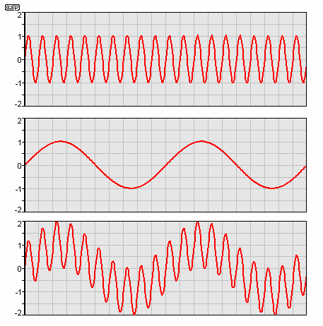
Intermodulation Distortion (IM)
Occurance: two different frequencies are being amplified simultaneously
one of frequency much lower than the other
high frequency signal modulated by the low frequency
different from the signals simply adding (as they are supposed to)
effect (musically speaking) is that the sound is muddied
Individual instruments become difficult to separate; their harmonics blend into a 'wall of sound'
from ESP - http://sound.westhost.com

Slide 77
Intermodulation Distortion (IM)
Signal includes components that are
the sum of the two frequencies and
the difference between the two frequencies
usually a fraction of a percent of the original signal
over 1% IM is noticeable
over 3% is annoying
from ESP - http://sound.westhost.com

Slide 78
Harmonic Distortion
The production of harmonic frequencies by an electronic system when A signal is applied at the input
when an input signal goes through nonlinear electronic circuitry, the output signal will include some harmonic distortion (or unwanted frequencies)
the frequency of each unwanted frequency is a multiple
(x1, x2, x3, etc.) of the centre frequency of the input signal
Odd And Even-order Distortion
if the frequencies of the distortion are 2, 4, 6, etc., times the centre frequency, it's even-order harmonics
if the frequencies of the distortion are 3, 5, 7, etc., times the centre frequency, it's odd-order harmonics

Slide 79
Total Harmonic Distortion
The ratio of the powers of:
sum of the power of all the harmonic components
the fundamental (required) signal
:
Usually expressed as a %
i.e. ∑ power of all harmonics
power of fundamental freq
= THD%

Slide 80
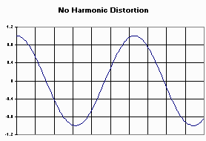
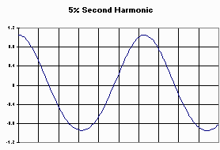
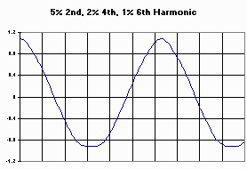
Total Harmonic Distortion
compare these even harmonic distortions
http://members.aol.com/sbench102/thd.html

Slide 81

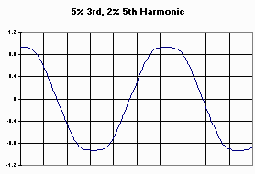
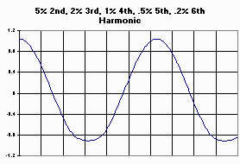

Total Harmonic Distortion
Odd harmonic distortions
compare the lower two:
this has higher THD in the 2nd and 3rd harmonics
… this has lower THD in the 2nd and 3rd harmonics

Slide 82


Slide 83
From Analogue to Digital

Slide 84
Analogue vs Digital Signals
Range of signal voltage:
V volts
0 volts
Analogue
offers an infinite range from 0 to V volts
at any point the signal voltage should be exactly a specific voltage
but there are many points in the chain where this specific voltage may be corrupted and subject to distortion (as previous slide)
Digital
offers a choice of only two values
Logical “0” = 0 volts
Logical “1” = V volts
(simplisticly...) a decision point between 0 and V volts
above this = “1”
below this = “0”
we can be (almost) certain that the signal is in either one state or the other
allows the signal to suffer much distotion before it is mis-read

Slide 85
Distortion Affecting Digital Signals
Data: “1”........ “0”......... “1”.......... “1”.......... “1” ......... “0” .......... “1” ........... “0” .......
V volts
0 volts
Specified Tolerances for Signals
“1” = V volts ±y volts
Tolerance on pulse shapes and timings
(e.g. in relation to a CLOCK)
“0” = W volts ±z volts
rise time
fall time

Slide 86
Digital Signal Timing - Clocking
Data: “1”........ “0”......... “1”........ “1”......... “1” ........ “0” ........ “1” ......... “0” .......
Time:
Transmitting and receiving ends must agree on times at which data is read – the CLOCK frequencies
Clocking information must also be inferred in recorded media (CDs, etc)

Slide 87
Go Digital!
Digital Signals are either “1” or “0”
Can add codings e.g. for error detection / correction
if 1’s and 0’s can represent the analogue voltage, the produced / reproduced signal can be much more robust and faithful
Aim: to keep the process digital as much as possible
Signal
Generation
Mixing
Production
Mastering
Master
Mass Produced Units
Signal
Reproduction
Analogue domain
Digital domain
Analogue domain

Slide 88
The Digital Chain of Production / Reproduction
digital mixing and mastering
digital reproduction format
digital signals
digital players
Signal
Generation
Mixing
Production
Mastering
Master
Mass Produced Units
Signal
Reproduction
Analogue domain
Digital domain
Analogue domain

Slide 89
ADC, DAC, Analogue and Digital Domains
Analogue signal in
Analogue Domain
Digital Domain
Transmission
Digital
Data
DSP
Audio
Signal
Sampling
ADC
Storage
Process / Integrate with other services
Digital
Data
DSP
Audio
Signal
DAC
Analogue signal out
DSP = Digital Signal Processing

Slide 90
Additional slides
Binary Systems
Sound, SPL and the logarithmic relationship
Sound measurement
Jerry Foss
jeremy.foss@bcu.ac.uk

Slide 91
Counting in Base 10
e.g. the number 2549
is – 2 x Thousand ... 5 x Hundred ... 4 x Ten ... 9 x one
i.e. 2 x 1000 + 5 x 100 + 4 x 10 + 9 x 1 = 2549
The composition of the decimal system in a more complex way:
Units are 10⁰ = 1
Tens are 10¹ = 10
Hundreds are 10² = 10 x 10
Thousands are 10³ = 10 x 10 x 10
… and so on
So 2549 is actually:
(2 x 10³) + (5 x 10²) + (4 x 10¹) + (9 x 10⁰)
= 2000 + 500 + 40 + 9 = 2549
(anything)⁰ = 1

Slide 92
Counting Bases
Counting to the base 10:
Counting to the base 7:
0
1
2
3
4
5
6
7
8
9
10
11
12
13
14
15
16
17
18
19
20
21
22
23
24
25
26
27
28
29
30
31
32
33
34
35
36
37
38
39…
0
1
2
3
4
5
6
10
11
12
13
14
15
16
20
21
22
23
24
25
26
30
31
32
33
34
35
36
40
41
42
43
44
45
46
50
51
52
53
54
55
56
60
61
62
63
64
65
66
100
101
102
103
104
105
106
… this is the decimal system
least significant digit, i.e. units have least value compared to tens and hundreds

Slide 93
Counting Bases – The Binary System
Binary System = counting to the base 2
0
1
10
11
100
101
110
111
1000
1001
1010
1011
binary digits
bits

Slide 94
Counting Bases – The Binary System
Binary System = counting to the base 2
0
1
10
11
100
101
110
111
1000
1001
1010
1011
binary digits
most significant bit … “MSB”
bits
least significant bit … “LSB”

Slide 95
The Binary System
0
1
2
3
4
5
6
7
8
9
10
11
12
13
14
15
0
1
10
11
100
101
110
111
1000
1001
1010
1011
1100
1101
1110
1111
... it’s all about spotting the patterns ...

Slide 96
The Binary System
0
1
2
3
4
5
6
7
8
9
10
11
12
13
14
15
0000
0001
0010
0011
0100
0101
0110
0111
1000
1001
1010
1011
1100
1101
1110
1111
Filling in the “leading bits”
e.g.
Binary 10 = decimal 2
… filling in the leading bits …
10 becomes 0010
… or even 00000010
it’s still = decimal 2, but probably less confusing if we have a digital system based on 4 or eight bits
Digital systems can have 8, 16, 32 or 64 bits (e.g. computer buses)

Slide 97
The Binary System
0
1
2
3
4
5
6
7
8
9
10
11
12
13
14
15
0000
0001
0010
0011
0100
0101
0110
0111
1000
1001
1010
1011
1100
1101
1110
1111
This is using four bits to count
= “four bit binary”
translating decimal numbers to binary
(here, from 0 to 15) is
“binary coded decimal” ... BCD
For three bits there are 8 combinations
... from 0 to 7
For four bits there are 16 combinations
... from 0 to 15
... and so on
least significant bit … LSB
most significant bit … MSB

Slide 98
The Binary System
0
1
2
3
4
5
6
7
8
9
10
11
12
13
14
15
0
1
10
11
100
101
110
111
1000
1001
1010
1011
1100
1101
1110
1111
0
1
consider the frequency of change for each column – notice the pattern
LSB

Slide 99
The Binary System
0
1
2
3
4
5
6
7
8
9
10
11
12
13
14
15
0
1
10
11
100
101
110
111
1000
1001
1010
1011
1100
1101
1110
1111
The frequency of the second column is half the LSB column

Slide 100
The Binary System
0
1
2
3
4
5
6
7
8
9
10
11
12
13
14
15
0
1
10
11
100
101
110
111
1000
1001
1010
1011
1100
1101
1110
1111
The frequency of the third column is half the second

Slide 101
The Binary System
0
1
2
3
4
5
6
7
8
9
10
11
12
13
14
15
0
1
10
11
100
101
110
111
1000
1001
1010
1011
1100
1101
1110
1111

Slide 102
The Binary System
0
1
2
3
4
5
6
7
8
9
10
11
12
13
14
15
0000
0001
0010
0011
0100
0101
0110
0111
1000
1001
1010
1011
1100
1101
1110
1111
now consider each of these binary pulses being transmitted as signals on a system

Slide 103
The Binary System
0
1
2
3
4
5
6
7
8
9
10
11
12
13
14
15
=
=
=
=
=
=
=
=
=
=
=
=
=
=
=
=
0000
0001
0010
0011
0100
0101
0110
0111
1000
1001
1010
1011
1100
1101
1110
1111
1
1
1
1
1
1
1
1
1
1
1
1
1
1
1
1
0000
0001
0010
0011
0100
0101
0110
0111
1000
1001
1010
1011
1100
1101
1110
1111
=
=
=
=
=
=
=
=
=
=
=
=
=
=
=
=
=
=
=
=
=
=
=
=
=
=
=
=
=
=
=
=
16
17
18
19
20
21
22
23
24
25
26
27
28
29
30
31
we can repeat the four LSB columns .. but if we add a new MSB column (red) we can double the counting capacity
columns are the same

Slide 104
The Binary System
0
1
2
3
4
5
6
7
8
9
10
11
12
13
14
15
=
=
=
=
=
=
=
=
=
=
=
=
=
=
=
=
0000
0001
0010
0011
0100
0101
0110
0111
1000
1001
1010
1011
1100
1101
1110
1111
1
1
1
1
1
1
1
1
1
1
1
1
1
1
1
1
0000
0001
0010
0011
0100
0101
0110
0111
1000
1001
1010
1011
1100
1101
1110
1111
=
=
=
=
=
=
=
=
=
=
=
=
=
=
=
=
=
=
=
=
=
=
=
=
=
=
=
=
=
=
=
=
16
17
18
19
20
21
22
23
24
25
26
27
28
29
30
31
10
10
10
10
10
10
10
10
10
10
10
10
10
10
10
10
0000
0001
0010
0011
0100
0101
0110
0111
1000
1001
1010
1011
1100
1101
1110
1111
=
=
=
=
=
=
=
=
=
=
=
=
=
=
=
=
32
33
34
35
36
37
38
39
40
41
42
43
44
45
46
47
Now add another column of “10”

Slide 105
The Binary System
0
1
2
3
4
5
6
7
8
9
10
11
12
13
14
15
=
=
=
=
=
=
=
=
=
=
=
=
=
=
=
=
0000
0001
0010
0011
0100
0101
0110
0111
1000
1001
1010
1011
1100
1101
1110
1111
1
1
1
1
1
1
1
1
1
1
1
1
1
1
1
1
0000
0001
0010
0011
0100
0101
0110
0111
1000
1001
1010
1011
1100
1101
1110
1111
=
=
=
=
=
=
=
=
=
=
=
=
=
=
=
=
=
=
=
=
=
=
=
=
=
=
=
=
=
=
=
=
16
17
18
19
20
21
22
23
24
25
26
27
28
29
30
31
10
10
10
10
10
10
10
10
10
10
10
10
10
10
10
10
0000
0001
0010
0011
0100
0101
0110
0111
1000
1001
1010
1011
1100
1101
1110
1111
=
=
=
=
=
=
=
=
=
=
=
=
=
=
=
=
32
33
34
35
36
37
38
39
40
41
42
43
44
45
46
47
11
11
11
11
11
11
11
11
11
11
11
11
11
11
11
11
0000
0001
0010
0011
0100
0101
0110
0111
1000
1001
1010
1011
1100
1101
1110
1111
=
=
=
=
=
=
=
=
=
=
=
=
=
=
=
=
=
48
49
50
51
52
53
54
55
56
57
58
59
60
61
62
63
64
1000000

Slide 106
The Binary System ... The Powers Of 2
Let’s review binary counting from the point of view of the powers of 2:
2⁰ = 1
2¹ = 2
2² = 4
2³ = 8
now assign these values to each of the columns ...
MSB ... ... LSB
2³ 2² 2¹ 2⁰
=8 =4 =2 =1
0 0 0 0 = 0 .... .... .... .... .... .... = 0
0 0 0 1 = 1 x 20 .... .... .... .... .... .... = 1
0 0 1 0 = 1 x 2¹ .... .... .... .... .... .... = 2
0 0 1 1 = 1 x 2⁰ + 1 x 2¹ = 1 + 2 = 3
0 1 0 0 = 1 x 2² = 4 .... .... .... .... = 4
0 1 0 1 = 1 x 2² + 1 x 2⁰ = 4 + 1 .... = 5

Slide 107
The Binary System ... Milestones
Specific patterns that are fairly recognisable, or lodge in the memory after lots of use (!)
0000 = 0
0010 = 2
0100 = 4
1000 = 8
10000 = 16
100000 = 32
11 = 3
111 = 7
1111 = 15
11111 = 31
1010 = 10

Slide 108
Hexadecimal
Four bit binary has the capacity to count from 0 to 15
(i.e. 16 combinations)
5 bit binary ... 0 to 31 .... 32 combinations
6 bit binary ... 0 to 63 .... 64 combinations
7 bit binary ... 0 to 127 .... 128 combinations
8 bit binary ... 0 to 255 ... 256 combinations
In hexadecimal
For four bit (0-15) alpha-numeric characters are used to count beyond decimal 9:
0000
0001
0010
0011
0100
0101
0110
0111
=
=
=
=
=
=
=
=
0
1
2
3
4
5
6
7
=
=
=
=
=
=
=
=
0
1
2
3
4
5
6
7
1000
1001
1010
1011
1100
1101
1110
1111
=
=
=
=
=
=
=
=
8
9
10
11
12
13
14
15
=
=
=
=
=
=
=
=
8
9
A
B
C
D
E
F
A hexadecimal number is preceded with the hash character “#”
e.g. hex C is written as #C

Slide 109
Hexadecimal
0000
0001
0010
0011
0100
0101
0110
0111
=
=
=
=
=
=
=
=
0
1
2
3
4
5
6
7
=
=
=
=
=
=
=
=
#0
#1
#2
#3
#4
#5
#6
#7
1000
1001
1010
1011
1100
1101
1110
1111
=
=
=
=
=
=
=
=
8
9
10
11
12
13
14
15
=
=
=
=
=
=
=
=
#8
#9
#A
#B
#C
#D
#E
#F
0011 1011 = #3B = decimal 59
0111 1111 = #7F = decimal 127
0100 0101 = #45 = decimal 69
1010 1101 = #AD = decimal 173
Note even if a hex number is only numric characters, the decimal equivalent will be different

Slide 112


Linear / Logarithmic Relationship
Linear relationship
Logarithmic relationship
(Depending on what’s being measured, can be this orientation …
On a linear scale
(ii) On a log scale

Slide 113
Sound Intensity: The Ear’s Response
Power
Area
The human ear can detect a large range of intensities
Sound measurements are made relative to a
standard threshold of hearing intensity, I₀
where I₀ = 10⁻¹² W/m²
Measured as the ratio of:
intensity I : threshold of hearing intensity I_{0 ;} i.e. =
Usual context is the sound intensity at the listener’s location
... and relative to the standard threshold of hearing (I₀)
Intensity =
Wm⁻²
Decibels:
a ratio of one quantity compared to another
Acoustics:
sound
Electronics, signals:
power
voltage
i.e. I(dB) = 10log₁₀

Slide 114
Logarithms
n =
the power to which you raise b (the base) …
to get a
b^{n} = a … e.g. 10³ = 1000
log_{b}(a) = n i.e. log₁₀(1000) = 3
example (ii) since 10^{0.301}=2
so log₁₀2 = 0.301
Used for calculations, e.g. multiplication:
log (m x n) = log(m) + log(n)
log (m / n) = log(m) – log(n)
Example: 2 x 3 = 6
… can be calculated from: log₁₀ (2x3) = log₁₀2 + log₁₀3
= 0.301 + 0.477
= 0.778
this is the log, so we need to antilog: antilog₁₀0.778 = 6
Usual bases are log₁₀ or log_{e}

Slide 115

Logarithms
y = log₁₀x
passes through x=1
- since anything to
the power of 0 = 1
y
log₁₀100= 2.00
log₁₀1000= 3.00
3
2
1
-1
-2
-3
y = log₁₀x
0 1 2 3 4 5 6 7 8 9 10
x
log₁₀2= 0.301
log₁₀10= 1.00
log₁₀0.5= -0.301
log₁₀0.1= -1
log₁₀0.01= -2
log₁₀0.001= -3
etc

Slide 116
Logarithms
decade
e.g.1 to 10
linear scale
decade
e.g. 0.1 to 1.0
decade
e.g.10 to 100
decade
e.g.1000 to 10000
decade
e.g.100 to 1000
log scale

Slide 117
Decibels
For measurement of power:
Where a₀ is a specified reference level
This can usually (conveniently) set to =1, so therefore can be ignored
is the ratio of sound a
compared to
the reference level a₀
a dB
10 times ... because we want decibels
“just noticable difference”
=1dB

Slide 118
Decibels in Practice
0dB = no gain, and no loss
if p is 10db greater than q … then p is ten times the power of q
if p is 3dB greater than q … then p is twice the power of q
(in electronics a power gain of x2 = 3dB;
however, a voltage gain of x2 is 6dB)
Cascading Circuits: multiply the gain = add the decibels
V_{in}
V_{out}
Gain = 100 x 10 = 1000
In decibels this is
20dB + 10dB = 30dB
x100
x10
20db
10db

Slide 119
Decibels
Example:
The intensity I measured is 10,000 times the threshold
∴ the ratio of the intensity I to the threshold intensity I₀ is 10⁴
the power of ten is 4, and the intensity is 40 dB:
log₁₀10,000= 4

Slide 120

Decibels
decibels:
10log₁₀x … … … x
i.e.
one hundred times = 20dB
ten times = 10dB
if we start with “1”
a tenth is = -10dB
a hundredth = -20dB
etc …
…
…

Slide 121

Decibels:
For Audio Power
(or other power)
10x the Power
= +3dB
Original sound intensity
TWICE the Power
= +3dB
SAME POWER
= 0dB
HALF the Power
= -3dB
http://www.phys.unsw.edu.au/jw/dB.html

Slide 122



Decibels – What they sound like
Go here (University of New South Wales) for flash version
http://www.animations.physics.unsw.edu.au/jw/dB.htm

Slide 123
A,B, and C Contours
To measure sound loudness, as distinct from an objective intensity measurement, the sensitivity of the ear must be factored in
10
0
-10
-20
-30
-40
-50
A
C
Relative Response, dB
B & C
B
Applied to tools to assimilate the human ear
A
20 50 100 200 500 1000 2000 5000 10000 20000
Frequency, Hz
A-contour - approximates the ear at low sound levels
eliminates inaudible low frequencies; widely used
B-contour - approximates the ear for medium loud sounds; rarely used
C-contour - approximates the ear at very high sound levels
used for traffic noise surveys in noisy areas
dBA
dBB
dBC

Slide 124

The Phon
related to dB by the psychophysically measured frequency response of the ear
At 1 kHz, readings in phons and dB are, defined as equal
The phon scale is then determined for all other frequencies based on subjective listening tests with volunteers
volunteers were asked to adjust the loudness of a signal at a given frequency until they judged its loudness to equal that of a 1 kHz signal
Fletcher-Munson curves - converts dB to phons
depends on sound level (it becomes flatter at high sound levels)

Slide 125
Decibels, Power – Absolute Measurements
ELECTRIC POWER, dBm or dBmW
dB (1mW) – power measurement relative to 1 milliwatt.
denoted as X dbm
dBW
dB(1W) – similar to dBm, except the reference level is 1 Watt
0 dBW = +30dBm;
−30 dBW = 0 dBm;
Xdbw = Xdbm − 30
30 …
because 30dB is 1000x
and 1W = 1000mW

Slide 126

Decibels, Voltage – Absolute Measurements
dBV
dB(1V_{RMS})
voltage relative to 1 volt (regardless of impedance)
dBu
0.775V as reference , i.e. dB(0.775 V_{RMS})
voltage relative to 0.775 volts
(diagram, right) the relationship between dBu (the voltage source) and dBm (the power dissipated as heat by the 600 Ω resistor)
(historical reasons) - the voltage level which delivers 1 mW of power in a 600 ohm resistor (standard reference impedance in telephone audio circuits)
originally dBv, it was changed to dBu to avoid confusion with dBV
= 0.775 V_{RMS}

Slide 127
Line Level
Most common nominal levels:
Consumer equipment is -10 dBV
Professional equipment is 4 dBu
Convention - nominal levels always written with sign symbol 4 dBu is +4dBu
In absolute terms
a signal at -10 dBV ≡ a sine wave, peak amplitude of ∼ 0.447 volts
a signal at +4 dBu ≡ sine wave, peak amplitude ∼ 1.737 volts

Slide 129


Moving Coil Meter

Slide 130

LEDs Circuits
Cathode
R1
R1 limits current
allows LED to light
protects LED by restricting current through it
restricts amount of current drawn from the power supply to conserve power
Anode
www.personeel.glr.nl/koster/elektro/led.htm
Conventionally, the longer connector is the anode (+ve)
Voltage drop
Silicon diodes (all Si diodes, not just LEDs) have a voltage drop of 0.7Volts
e.g. - if power supply = 5V, 4.3V will be dropped across R1

Slide 131






LEDs Circuits
Arrays of LEDs
each LED individually operated
e.g. by logic circuits
to produce simple displays
bars
seven segment
etc
...pins...
http://www.highwaygold.co.uk/science/technology/electronics/components/optoelectronics/led/

Slide 132

Dynamic range
Dynamic Range: The difference between the highest and lowest acceptable levels.
Arrange for:
the loudest peaks to be below the maximum level which the system can handle
and for the quietest signals to be kept well above the noise floor
Meters – mostly for avoiding overloads and maximising signal-to-noise ratio
level meters on recorders and consoles mainly intended as an aid to balancing sound levels
Simply matching peak meter levels between different sources is not consistent

Slide 133


RTA & Level-History Metering
Real-Time Spectrum Analyser (RTA)
programme level varies in different parts of the frequency spectrum
many different measuring standards for RTAs (like programme level meters):
meter ballistics
numbers and widths of the separate measuring bands,
meter for history of programme levels
Goldwave - spectrum analysis
Acuma Labs RTA-31
http://www.mackie.com/Products/d8b_v3/PlugIns/acuma/acuma.html

Slide 134


VU (Volume Unit) Meter
simplest of meter designs
display an approximation to the RMS voltage level of electrical signals
(ok for pure sine, but not for complex waves)
will usually read slightly lower than the true RMS value
but still useful and practical
inherently cheap - no complex peak-sensing driver circuitry involved
VU meters on different equipment react differently

Slide 135
VU (Volume Unit) Meter
Measures 'average' levels:
a sustained sound reads much higher than a brief percussive one
Even when both sounds have the same maximum voltage level:
reading is dependent on
amplitude
duration of peaks in the signal
standard VU response and fallback times exaggerate this effect ~300 mS each
∴ transients and percussive sounds barely register at all
… and can cause unexpected overloads
Supposed to be sensitive to both the positive and negative half-cycles
many budget units are sensitive only to one half of the waveform

Slide 136

PPM (Peak Programme) Meters
More precise and expensive than VU
Designed not to catch the fastest transient peaks
show transients which are sustained for a defined time
termed 'quasi-peak' meters
'Type I' meters
integration time of 5mS
'Type II' meters
Integration time ~10mS
∴ levels of transients usually exceed the PPM reading by between 4dB to 6dB
encourages overall programme levels to be driven slightly higher ∴ better S/N
assumes that overloading the briefest transients will be inaudible
effectively a peak-hold condition
some bar-graph level displays are available with a VU response shown as a solid bar plus floating dot above it which registers the PPM level

Slide 137

Headroom
the ability of the sound system to accommodate loud program peaks
e.g. two sound systems that both operate at the same nominal level
… the system with the greater headroom will be able to handle louder peaks before distorting or breaking

Slide 138
Headroom Requirements
change with the nature of the program material and the purpose for which the sound system is operated
PA in loud factory environment
needs very high nominal sound level (say 110dB) to overcome machinery but needs only ~6dB headroom
Rock band PA ~10dB headroom
Symphony orchestra concert
probably > 20dB headroom because
average level of the orchestra may be low say 90 dB
but on peaks may momentarily exceed 120dB SPL
∴ needs 30 dB of headroom
… if the sound system is capable of only 20dB of headroom, the peaks will be distorted

Slide 139

Meter Scales – Comparative Between Meters
Different audio metering scales developed by different industries in different countries
each optimises the display for a specific set of applications
VU: zero point at +4dBu*
Comparison of standards

Slide 140


Multiple Meters Used Together
e.g. stereo or multi-channel systems
each meter's dynamic response must match to within a tenth of a second and their amplitude responses should be within 0.3dB of each other in the critical areas of the meter range
In order to calibrate VU and PPM meters, it's best to use a mid-frequency sine tone (typically 1kHz), as these signals are the most accurately read by meters which are not truly peak-reading

Slide 141
Metering And Loudness
Level meters display information about signal voltages
rather than their perceived loudness
meters are only an aid to judging the acoustic balance of audio material
Specialist metering systems required for [perceived] loudness of a programme
taking into account the characteristics of human perception
also - broadcasting organisations are now transmitting hundreds of channels via satellite, cable and the internet
impossible to monitor all of them acoustically
Also - growing use of sophisticated multi-band compressors
possible to create audio material which appears completely normal on quasi-peak meters yet sounds extremely loud
causes problems at programme junctions

Slide 142

Metering And Loudness
Post-production houses monitor and regulate the true perceived loudness of films using loudness meters
common meter - Dorroughs
Thames Television and the ITC ...
- formulated a specification for displaying the relative loudness perception of typical audio programme material
Perception of loudness depends on -
level of a signal
frequency bandwidth
wider the bandwidth, the louder a signal seems to be
(even if its peak level remains constant)

Slide 143

Metering And Loudness
Human ear - most sensitive around 2-4kHz
signals in this frequency band will sound much louder than low- or high-frequency signals of similar peak level
e.g. band-limited 1/3-octave noise signals at 100Hz and 10kHz can be almost 15dB higher in level than noise centred on 4kHz …
...yet all will be perceived as sounding equally loud!
dB
0
-5
-10
-15
0 1 2 3 4 5 6 7 8 9 10 freq, kHz →

Slide 144

Metering for Digital Systems
Revision - Analogue - Digital Conversion
1111
1110
1101
1100
1011
1010
1001
1000 0111
0110
0101
0100
0011
0010
0001
0000

Slide 145
Metering for Digital Systems
Digital systems - transient overloads are clearly audible
∴ neither VU nor PPM metering is suitable
Digital equipment use true peak-reading meters
derived from the digital data stream
... not analogue level-sensing electronics
∴ can be extremely accurate.
Analogue meters all have a nominal alignment point — the zero reference
have a notional headroom above
signal peaks are routinely allowed into the first 8dB or so of this headroom
peaks of +12dBu will usually start to cause distortion
becomes more noticeable with increasing level ...
until clipping occurs, usually above +18dBu

Slide 146
Digital Systems
No headroom above the maximum quantisation level
∴ notional headroom created
by choosing a 'zero' point well below this
Digital meters scaled such that maximum quantisation level is denoted as 0dBFS (full scale)
so the alignment level is always a negative value below this point.
Europe Standard (by European Broadcasting Union)
0dBu = -18dBFS
∴ signal peaking at the top of the EBU-standard PPM scale
(therefore with true peaks at around +16dBu)
remains a little below the digital full scale value
American SMPTE
0dBu at -20dBFS instead...

Slide 147
Digital Systems
Problem: post-production and mastering situations
programme levels have been carefully controlled
these standard alignments typically cause most mixes to peak only below -10dBFS
Consequently, strong arguments for adopting a different alignment strategy in these circumstances
e.g. align 0dBu to -12dBFS for mastering work
however, there is as yet no standard calibration specifically for post-production applications.

Slide 148

“Over” Indicators
The problem:
Original recorded (analogue) signal
1100010010010000100010101000100010
Converted signal (digital, but shown here as the analogue)
Digitised signal, using full quantisation range
Digital processing requires increasing the amplitude, but this excedes the quantisation range
required amplified signal
maximum available signal

Slide 149
“Over” Indicators
Signal exceeds the maximum quantisation level
when the analogue input is greater than the available quantisation range
when some signal-processing operation results in a sample value larger than the maximum quantisation level
However - often less meaningful when metering an already-digitised audio without the benefit of the original source as a reference
Only way in which most digital meters can detect overloads in the audio data stream is by watching for consecutive samples with the maximum quantisation value
Commonly, four consecutive maximum-value samples are interpreted as an overload
… but some meters include an option for the user to specify this number.
However, four maximum quantisation values in a row does not necessarily imply an overload:
peak-level low-frequency signal could easily create four maximum-value samples quite legitimately
high-frequency signal could be severely distorted with just a couple of peak-value samples

Slide 151


Slide 153


Picture Line-up Generation Equipment - PLUGE
Generates test patterns
greyscale - adjust the black level and contrast
various PLUGE patterns,
most common - vertical bars of super-black, normal black, and near-black and two rectangles of mid-gray and white
included in the SMPTE colour bars
NTSC, PAL, and SECAM
first vertical bar (left) = black
not seen against the background
second vertical bar = only just visible as dark grey
third vertical bar = lighter gray and clearly visible
white box = comfortable level of true white
80Cd/m2 with a suitable light meter
no colour in PLUGE display
For monitor set up, see (for example):
https://documentation.apple.com/en/finalcutpro/usermanual/index.html#chapter=78%26section=9%26tasks=true
See also
100% bars
75% bars - NTSC

Slide 154


Diamond Display
Top diamond: Pb against Y
Bottom diamond: Pr against Y
Tested on test equipment – e.g. Tektronix waveform monitor (below)
Anything outside the diamonds is outside of the gamut (NTSC, or other suitable colour space)

Slide 155


